Slide 1

Consistent Tangent Computation for Nonlinear FEM via Hyper-complex Numbers
David Restrepo, Santiago Garcia Botero
* Department of Mechanical, Aerospace, and Industrial Engineering. The University of Texas at San Antonio
$\text{†}$ Department of Mechanical Engineering and Industrial Engineering. St. Mary's University
Hyper-Dual Differentiation in Nonlinear Finite Elements
January 2026

Slide 2
Hyper-Dual Differentiation in Nonlinear Finite Elements
Goal: Provide robust + efficient first-derivative computation for nonlinear solves (Newton), and validate methods against a trusted reference.
What we built: A UEL-based testbed that isolates the derivative problem:
Same physics / same residual across all methods
Only the tangent (Jacobian) computation changes
Automated runs + automated plots for runtime / accuracy / Newton behavior
Outcome: We now have a benchmarked “derivative engine playground” that’s ready to be ported to UMAT + 3D elements.

Slide 3
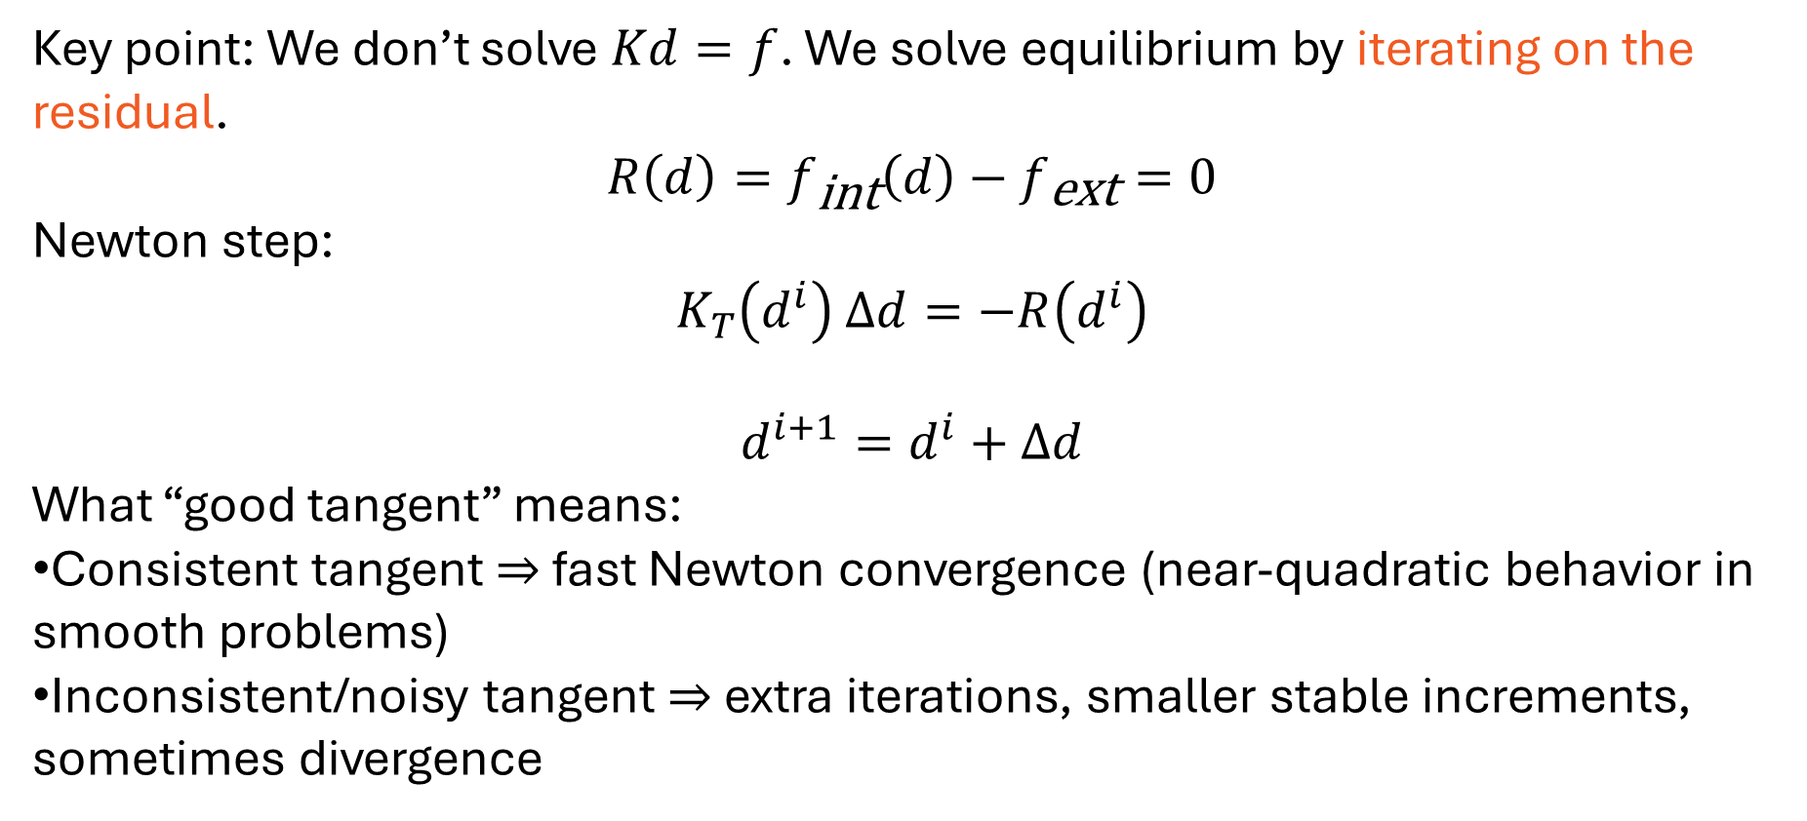
Hyper-Dual Differentiation in Nonlinear Finite Elements
Key point: We don’t solve $Kd=f$. We solve equilibrium by iterating on the residual.
$$R\left(d\right)=f_{\text{int}}\left(d\right)−f_{\text{ext}}=0$$
Newton step:
$$K_{T}\left(d^{i}\right) Δd=−R\left(d^{i}\right)$$
$$d^{i+1}=d^{i}+Δd$$
What “good tangent” means:
Consistent tangent ⇒ fast Newton convergence (near-quadratic behavior in smooth problems)
Inconsistent/noisy tangent ⇒ extra iterations, smaller stable increments, sometimes divergence

Slide 4
Hyper-Dual Differentiation in Nonlinear Finite Elements
We implemented multiple tangent strategies under a single residual model:
Exact analytic tangent (reference baseline)
Finite differences (FD) (real perturbation)
Complex-step / hypercomplex (imaginary perturbation; no subtractive cancellation)
Hyperdual (2-channel forward AD) (two Jacobian columns per evaluation)
OTI / multi-channel forward AD (generalization; pack more directions per call, if used)
Key design constraint: identical physics; only derivative engine changes.

Slide 5
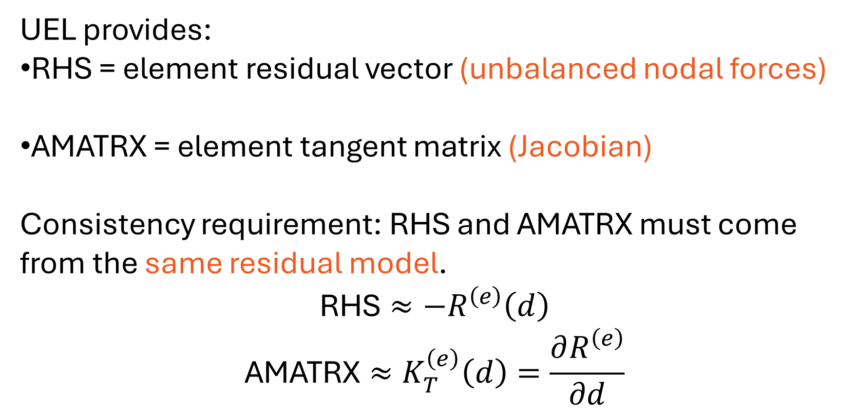
Hyper-Dual Differentiation in Nonlinear Finite Elements
UEL provides:
RHS = element residual vector (unbalanced nodal forces)
AMATRX = element tangent matrix (Jacobian)
Consistency requirement: RHS and AMATRX must come from the same residual model.
$$\text{RHS}≈−R^{\left(e\right)}\left(d\right)$$
$$\text{AMATRX}≈K_{T}^{\left(e\right)}\left(d\right)=\frac{∂R^{\left(e\right)}}{∂d}$$

Slide 6
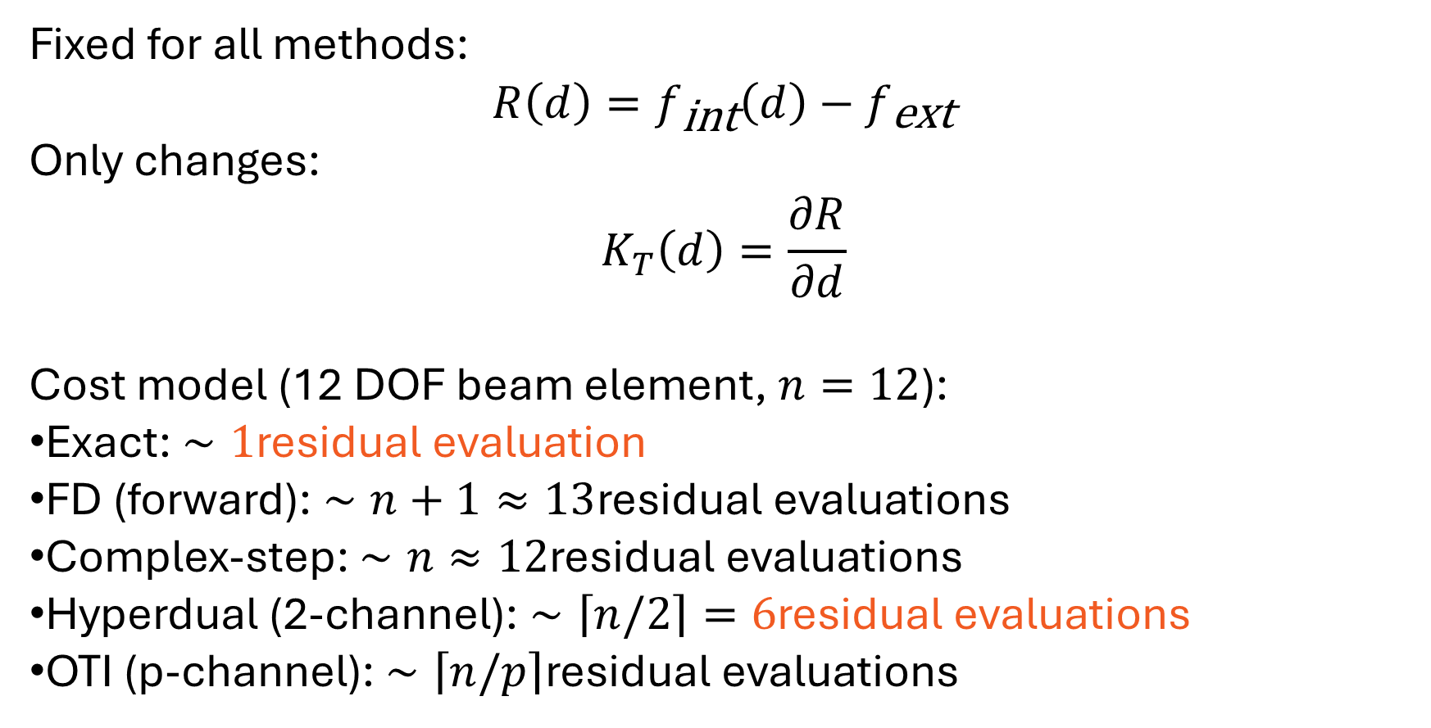
Hyper-Dual Differentiation in Nonlinear Finite Elements
Fixed for all methods:
$$R\left(d\right)=f_{\text{int}}\left(d\right)−f_{\text{ext}}$$
Only changes:
$$K_{T}\left(d\right)=\frac{∂R}{∂d}$$
Cost model (12 DOF beam element, $n=12$):
Exact: $∼1$residual evaluation
FD (forward): $∼n+1≈13$residual evaluations
Complex-step: $∼n≈12$residual evaluations
Hyperdual (2-channel): $∼\left\lceil n/2\right\rceil =6$residual evaluations
OTI (p-channel): $∼\left\lceil n/p\right\rceil$residual evaluations

Slide 7
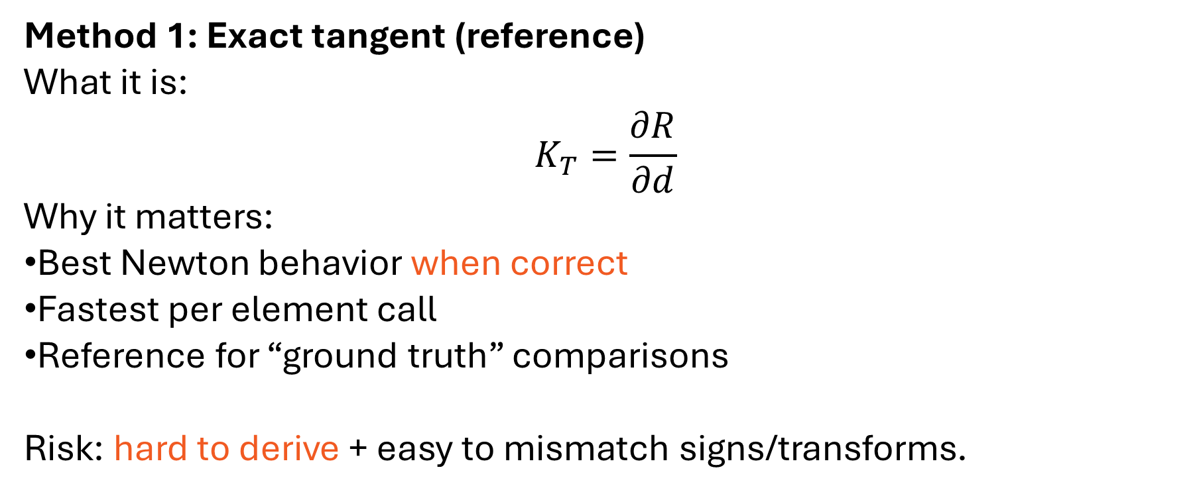
Hyper-Dual Differentiation in Nonlinear Finite Elements
Method 1: Exact tangent (reference)
What it is:
$$K_{T}=\frac{∂R}{∂d}$$
Why it matters:
Best Newton behavior when correct
Fastest per element call
Reference for “ground truth” comparisons
Risk: hard to derive + easy to mismatch signs/transforms.

Slide 8
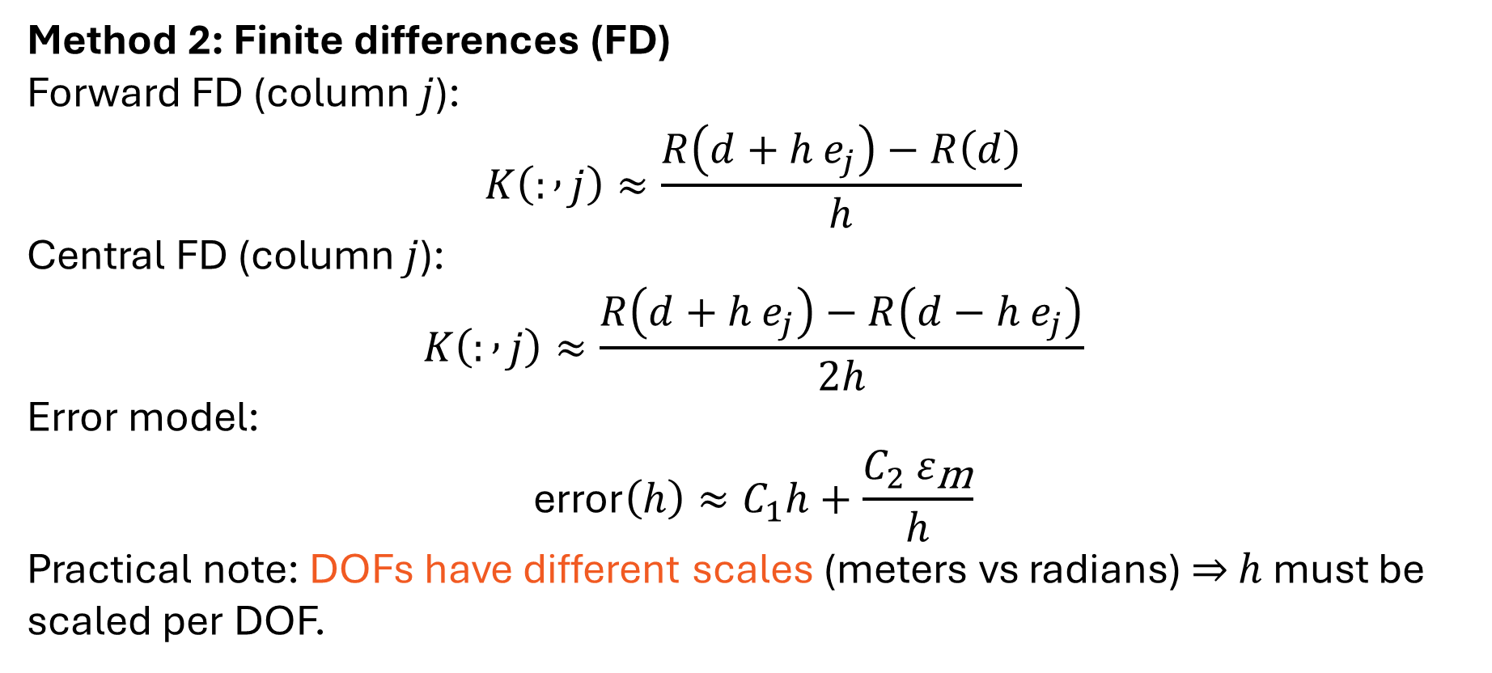
Hyper-Dual Differentiation in Nonlinear Finite Elements
Method 2: Finite differences (FD)
Forward FD (column $j$):
$$K\left(: , j\right)≈\frac{R\left(d+h e_{j}\right)−R\left(d\right)}{h}$$
Central FD (column $j$):
$$K\left(: , j\right)≈\frac{R\left(d+h e_{j}\right)−R\left(d−h e_{j}\right)}{2h}$$
Error model:
$$\text{error}\left(h\right)≈C_{1}h+\frac{C_{2} ε_{\text{m}}}{h}$$
Practical note: DOFs have different scales (meters vs radians) ⇒ $h$must be scaled per DOF.

Slide 9
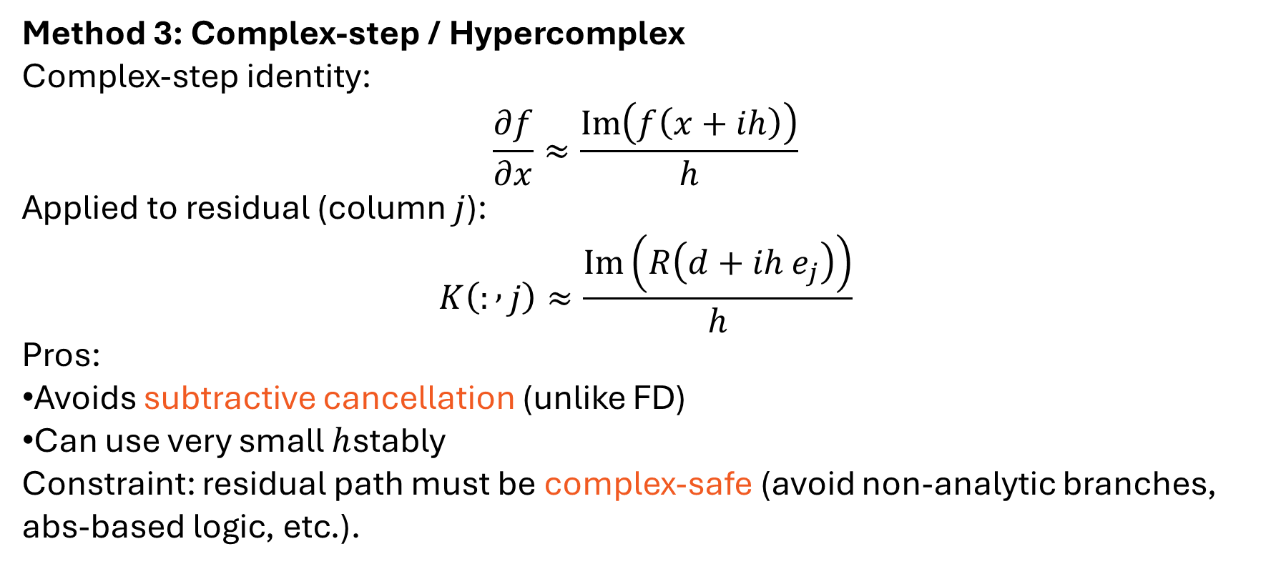
Hyper-Dual Differentiation in Nonlinear Finite Elements
Method 3: Complex-step / Hypercomplex
Complex-step identity:
$$\frac{∂f}{∂x}≈\frac{\operatorname{Im}\left(f\left(x+ih\right)\right)}{h}$$
Applied to residual (column $j$):
$$K\left(: , j\right)≈\frac{\operatorname{Im}\left(R\left(d+ih e_{j}\right)\right)}{h}$$
Pros:
Avoids subtractive cancellation (unlike FD)
Can use very small $h$stably
Constraint: residual path must be complex-safe (avoid non-analytic branches, abs-based logic, etc.).

Slide 10
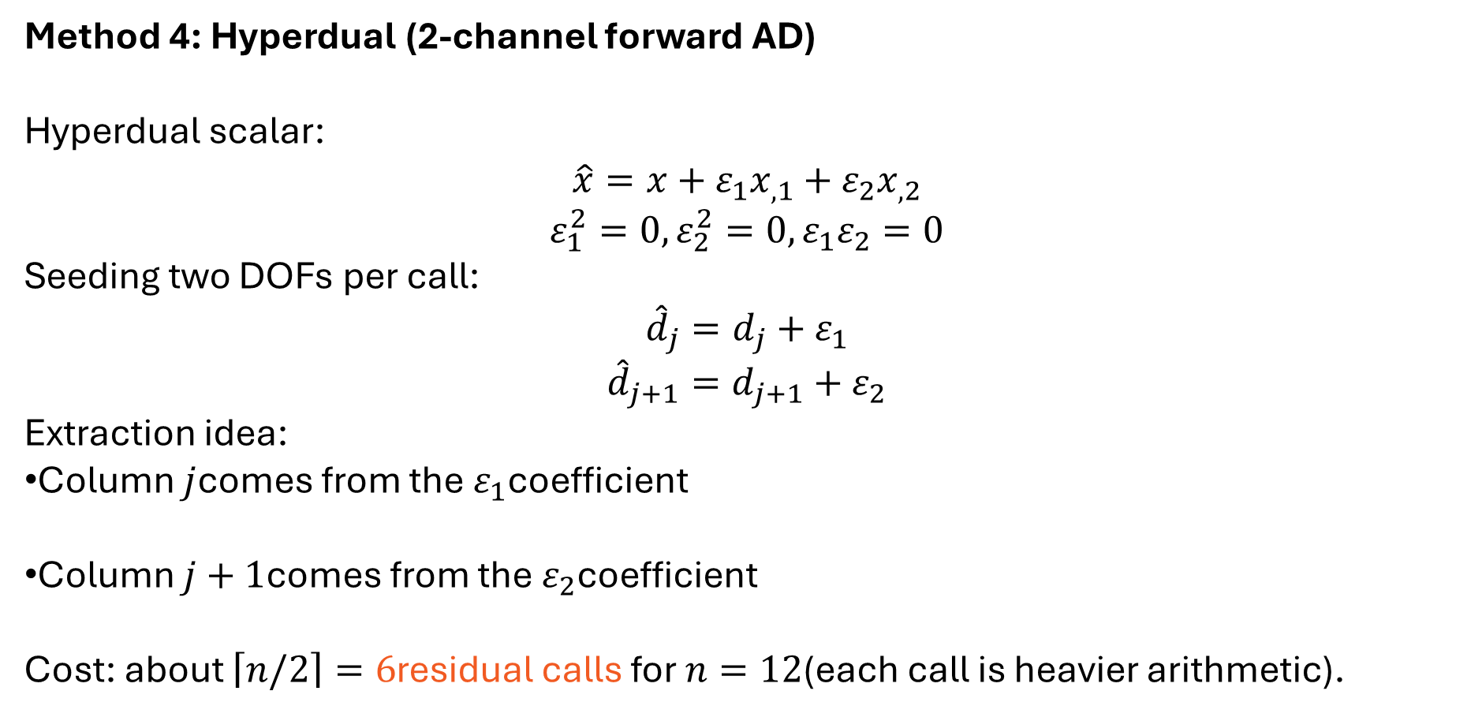
Hyper-Dual Differentiation in Nonlinear Finite Elements
Method 4: Hyperdual (2-channel forward AD)
Hyperdual scalar:
$$\hat{x}=x+ε_{1}x_{,1}+ε_{2}x_{,2}$$
$$ε_{1}^{2}=0, ε_{2}^{2}=0, ε_{1}ε_{2}=0$$
Seeding two DOFs per call:
$${\hat{d}}_{j}=d_{j}+ε_{1}$$
$${\hat{d}}_{j+1}=d_{j+1}+ε_{2}$$
Extraction idea:
Column $j$comes from the $ε_{1}$coefficient
Column $j+1$comes from the $ε_{2}$coefficient
Cost: about $\left\lceil n/2\right\rceil =6$residual calls for $n=12$(each call is heavier arithmetic).

Slide 11
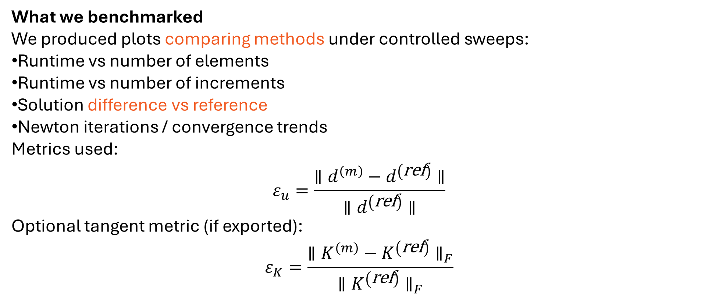
Hyper-Dual Differentiation in Nonlinear Finite Elements
What we benchmarked
We produced plots comparing methods under controlled sweeps:
Runtime vs number of elements
Runtime vs number of increments
Solution difference vs reference
Newton iterations / convergence trends
Metrics used:
$$ε_{u}=\frac{∥d^{\left(m\right)}−d^{\left(\text{ref}\right)}∥}{∥d^{\left(\text{ref}\right)}∥}$$
Optional tangent metric (if exported):
$$ε_{K}=\frac{∥K^{\left(m\right)}−K^{\left(\text{ref}\right)}∥_{F}}{∥K^{\left(\text{ref}\right)}∥_{F}}$$

Slide 12
Hyper-Dual Differentiation in Nonlinear Finite Elements

Slide 13
Hyper-Dual Differentiation in Nonlinear Finite Elements
Key results (what we achieved)
Bottom line:
We now have a verified derivative computation harness that compares methods apples-to-apples.
We can quantify tradeoffs: accuracy vs runtime, stability vs sensitivity (FD step size), and effect on Newton behavior.
Interpretation (talking points):
Exact is the benchmark
FD is universal but tuning-sensitive and slow
Complex-step is very accurate if the code path is analytic-safe
Hyperdual/OTI offers robust AD-style derivatives with fewer residual calls by packing directions

Slide 14
Hyper-Dual Differentiation in Nonlinear Finite Elements
Next step: move from UEL beams → UMAT with 3D elements
What changes:
From beam element verification → full 3D constitutive update setting
Tangent becomes the consistent material Jacobian in UMAT context (still first derivatives; still Newton-critical)
Plan:
Implement UMAT derivative strategy using the best-performing approach from the UEL benchmark as the starting point
Use the same verification logic (reference comparisons / error estimation)
Start on a minimal 3D element test problem, then scale to the real model
Ask / alignment needed:
Confirm the UMAT target model components (state variables, inputs/outputs)
Confirm the required derivative set per Newton iteration
Provide (or we generate) a minimal driver/test case with representative numbers

Slide 15
Thank you
Any questions ?

